Slide 1
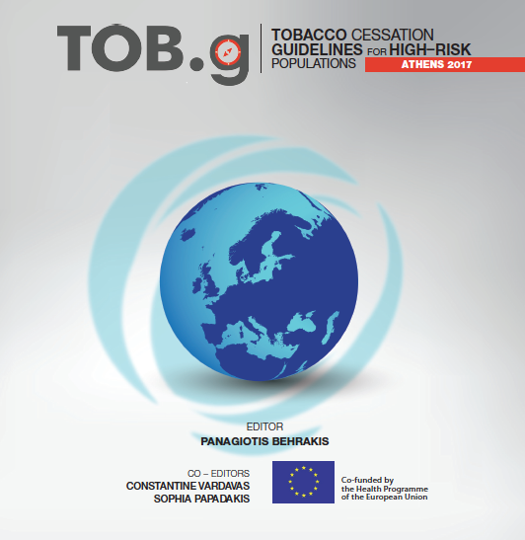
Tobacco Cessation Guidelines for COPD
Sheila Keogan, Luke Clancy (on behalf of the Tob-G partners).
TobaccoFree Research Institute Ireland
￼
This project was co-funded by the Health Programme of the European Union
grant agreement No. 664292 — TOB-G — HP-PJ-2014
BACKGROUND
Tobacco use is the main risk factor for the development of COPD . Tobacco users have a 50% greater probability of developing COPD during their lifetime. Second-hand smoke exposure is associated with reduced health status and increased exacerbations among COPD patients. There is a link between passive smoking in childhood and the development of COPD in adulthood.
Smoking cessation is the most effective treatment for reducing the rate of COPD progression and is highly cost-effective.
Respiratory symptoms ameliorate after 3-9 months after quitting and lung function may increase by 10%.
Despite the importance of smoking cessation in COPD many patients fail to quit. The possible causes of this include the complexity of the disease, perception of aetiology, comorbidities such as poor mental health where depression and anxiety are very common and prevalence of severe dependence, combined smoking and abuse of alcohol.
Respiratory physicians and all respiratory healthcare professionals should be trained in evidence based treatments and be prepared to provide smoking cessation including pharmacological and counselling services to their COPD patients.
OBJECTIVES
We aimed to provide an individualized approach to smoking cessation for patients with Chronic Obstructive Pulmonary disease as they require a tailored approach to treatment.
METHODS
The GRADE evidence grading system was used to rate the quality of evidence supporting each of the recommendations. The evidence grading scale reflects the type, quality and quantity of available evidence supporting the guideline recommendation. GRADE uses 4 evidence grading categories:
(A)‘high’, (B)‘moderate’,(C)‘low’, (D)‘very low’
RESULTS
Table 1: Quit Smoking Medications with Proven Efficacy among COPD Patients
Substance | MODE OF APPLICATION | DOSAGE | SPECIAL REMARKS
Nicotine Replacement Therapy | Patch | 3 Strengths( differ by manufacturer) To be used over 16 or 24 hours | Long acting (24 hours) May be used in combination with fast acting NRT. Possible skin reaction
 | Chewing Gum | 2mg, 4mg maximum daily dose: 25 pieces 2mg or 15 pieces 4mg. | Problematic in patients wearing dentures. Undesirable side effects: heartburn, oral irritation
 | Sublingual Lozenge | 2mg Maximum daily dose 30 lozenges | Fast acting. Undesirable side effects: oral irritation
 | Lozenge | 1mg,2mg, and 4 mg, maximum daily dose 30 lozenges(2mg Lozenge) | Fast acting. Undesirable side effects: oral irritation
 | Nasal Spray | 0.5mg per actuation, Maximum dosage: twice per hour in each nostril. | Fast acting. Undesirable side effects: irritation of the mucosa
Varenicline | Tablet | 0.5mg 1x daily for 3 days, then 0.5x 2 daily for 4 days followed by quitting smoking between day 8 and day 15 of meds, followed by 1mg x 2 daily for 12 weeks | Undesirable side effects: Nausea, vivid dreams
Bupropion | Tablet | 150mg 1 daily for 7 days, followed by quitting smoking, followed by 150mg x 2 daily. Total duration of treatment 8 weeks | Undesirable side effects: cerebral seizures, nausea, sleep disturbances.
RESULTS
Profile of Tobacco Users with COPD
They smoke more, inhale deeper and are more addicted to tobacco
They find it more difficult to quit than the general population of tobacco users.
Co-existence of depression, anxiety, are associated with a lack of motivation and self-confidence for quitting.
Treatment
Understanding and tailoring cessation interventions may assist with increasing effectiveness of smoking cessation treatments.
Three first-line pharmacotherapies have been shown to double or triple six month smoking abstinence compared to placebo.
High dose NRT is recommended for patients who report moderate to high levels of nicotine addiction.
Table 2:Proposed initial doses of nicotine replacement therapy
TIME TO FIRST CIGARETTE IN THE MORNING | Number of Cigarettes per day
 | < 10 cigs/day | 10-19 cigs/day | 20-30 cigs/day | > 30 cigs/day
< 5mins |  | Patch High Dose (0.9mg/h)+/- oral NRT | Patch High Dose (0.9mg/h)+/- oral NRT | 2 High Dose Patches (1.8mg/h)+/- oral NRT
< 30 mins |  | Patch High Dose (0.9mg/h) | Patch High Dose (0.9mg/h)+/- oral NRT | Patch High Dose (0.9mg/h)+/- oral NRT
< 60 mins after waking | No medication or oral NRT | Oral NRT | Patch High Dose (0.9mg/h) | Patch High Dose (0.9mg/h)+/- oral NRT
> 60 mins after waking | No medication or oral NRT | No medication or oaral NRT | Oral NRT
Not smoking daily | No medication or oral NRT | No medication or oaral NRT
The combination of two types of NRT with different types of delivery is highly recommended ^{a*}.
Increasing the length of time that NRT is used: up to six or twelve months can increase abstinence rates compared to the standard 10 weeks of NRT therapy ^{a*.}
Compared with intensive counselling, pharmacotherapy was cost saving and dominated the other interventions. Intensive counselling and pharmacotherapy resulted in low costs per QALY gained with ratios comparable to results for smoking cessation in the general population
CONCLUSIONS
Smoking cessation interventions should be integrated into routine care of COPD patients who smoke, in both primary care and specialist settings ^{A*}.
Respiratory physicians and health professionals involved in the treatment of COPD should be trained in evidence-based smoking cessation treatment and be prepared to provide smoking cessation pharmacotherapy and counselling to their COPD patients or refer them to a colleague trained in smoking cessation ^{A*}.
A growing body of evidence suggests that the majority of COPD patients, in particular those who report high levels of nicotine dependence, will require structured and intensive smoking cessation support in order to quit^{B*}.
A combination of high-intensity counselling and pharmacotherapy is the most effective strategy for treating tobacco use among patients with COPD^{B*}.
*Evidence rating as in Methods.
Additional information:
Luke Clancy / Sheila Keogan
lclancy@tri.ie / skeogan@tri.ie
Ref: Project website http://tob-g.eu
Tob.g ISBN: 978-960-98654-6-3

