Slide 1
State of the Nation:
Europe and smoking
cessation provision-
results from EQUIPP
Prof Luke Clancy
Director General
TobaccoFree Research Institute Ireland,
Dublin

Slide 2
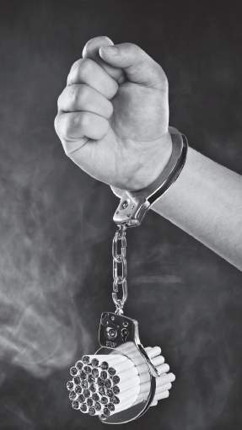
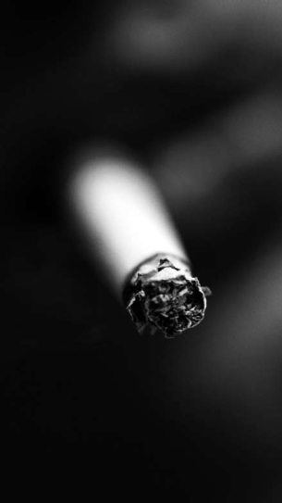
The challenge
650,000 people are killed every year by tobacco¹
Not enough is being done to combat tobacco dependence
All EU member states have signed up to The WHO’s Framework Convention on Tobacco Control (FCTC)²
Article 14 for the FCTC specifically covers demand reduction measures concerning tobacco dependence and cessation ²
Each Party should develop integrated guidelines based on scientific evidence and best practice to promote cessation of tobacco use, and provide treatment for tobacco dependence ²
1 Mladovsky P, Allen S, Masseria C et al. Health in the European Union, Trends and Analysis. 2009. European Observatory on Health Systems and Policies. World Health Organization 2 WHO Framework Convention on Tobacco Control, World Health Organization, Geneva, Switzerland, 2005. ISBN 92 4 159101 3

Slide 3
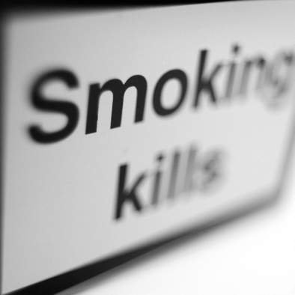
Introduction
The challenge
What is EQUIPP?
The Editorial Partners
Methodology
Areas of research
Key recommendations
An “ideal” country
Conclusions
The EQUIPP report authors

Slide 4
Europe Quitting: Progress and Pathways
Bridgehead International, EQUIPP: Europe Quitting: Progress and Pathways, London, 2011. European Respiratory Journal 2011

Slide 5
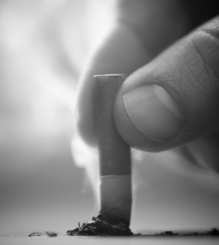
What is EQUIPP?
A comprehensive report looking at the current infrastructure of smoking cessation across Europe in terms of:
Service provision and accessibility
Tobacco control
Education
Guidelines
Providing recommendations specific to each country on how they can improve their current status
Share best practice
Notes:
5

Slide 6
Objectives
To spark debate and discussion around smoking cessation infrastructure across Europe by:
Reviewing the current status across a number of European countries (n=20)
Provide individual country reports that:
Summarise the current smoking cessation infrastructure and how it fits into tobacco control
Provides expert recommendations on what could be done to improve the situation
Provide a full report putting the country information into context across Europe
AIM: To equip policy-makers with the expertise and insight to improve smoking cessation infrastructure and drive down tobacco dependence

Slide 7
Structure
CONTENT:
The Smoking Epidemic
Legislation and Policy on Smoking
Smoking Cessation Services and Infrastructure for Tobacco Dependence Support
Guidelines and guidance
Education
Country Specific Details with comprehensive data about tobacco dependence and smoking cessation infrastructure
Key Recommendations
Notes:
- The look and feel of the report is still going through final amendments, but here are three graphics showing how it is likely to appear
It uses black and white imagery to drive home the stark reality of smoking to counter the “glamorous” pictures often used in smoking advertising and marketing. For example, you can expect to see parents smoking with children near by, or hospital patients banished to outside smoking areas in hospitals
It will also use graphics to represent some of the hard-hitting facts and stats about smoking across Europe. Instead of presenting these facts in tables, it will present them in a way that allows readers to immediately understand the scale of the issue and how countries compare to each other

Slide 8
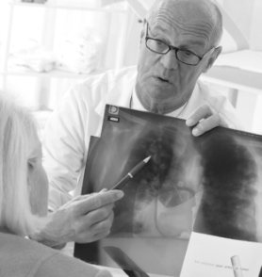
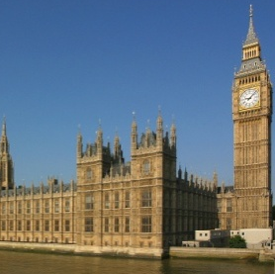
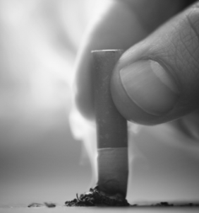
Impact and outcomes
Greater momentum towards better smoking cessation services and infrastructure across Europe
Debate at political level to further address the need for consistent smoking cessation services
Fewer people suffering from tobacco dependence

Slide 9
Publication and promotion
Published online and as a BMJ supplement
Media interviews with editorial partners
Photo stories for the media
Debates and discussions on findings
Policy launch to equip key decision -makers with facts and ideas for smoking cessation policy
Pan-European and national activity
Notes:
NOTES
_______________________________________________________________
_______________________________________________________________
_______________________________________________________________
_______________________________________________________________
_______________________________________________________________
_______________________________________________________________
_______________________________________________________________
_______________________________________________________________
_______________________________________________________________
_______________________________________________________________
_______________________________________________________________
_______________________________________________________________
_______________________________________________________________
_______________________________________________________________
_______________________________________________________________

Slide 10
Supporting countries across Europe
EQUIPP: Providing policy makers and healthcare professionals with pathways to enhance smoking cessation infrastructure and effectively treat tobacco dependence.
Practical advice for countries looking to improve the current smoking cessation services available to all smokers
Notes:
NOTES
_______________________________________________________________
_______________________________________________________________
_______________________________________________________________
_______________________________________________________________
_______________________________________________________________
_______________________________________________________________
_______________________________________________________________
_______________________________________________________________
_______________________________________________________________
_______________________________________________________________
_______________________________________________________________
_______________________________________________________________
_______________________________________________________________
_______________________________________________________________
_______________________________________________________________

Slide 11
Developing the Report
The EQUIPP report was initiated and funded by Pfizer, but has been independently written by a third party health economics agency along with an Editorial team
The Editorial Partners were selected for their broad range of knowledge and geographical location
Each Editorial Partner was involved from the very beginning of the report and have provided their approval and input on the content

Slide 12
Editorial Partners
Thomas Hering
Physician for pneumology, allergies and sleep medicine Vice-Chairman of the German Association of Pulmonologists
Berlin, Germany
Prof Luke Clancy
Director General TobaccoFree Research Institute Ireland
Dublin, Ireland
Prof Witold Zatoński
Director, Department of Cancer Epidemiology & Prevention Maria Sklodowska-Curie Memorial Cancer Center & Institute of Oncology
Warsaw, Poland
Antonella Cardone
Expert in Tobacco Control and Public Health Director, Global Smokefree Partnership
Rome, Italy

Slide 13
Methodology
Experts in each of the 20 countries studied were interviewed from June to October 2010 to provide opinion and recommendations
Factual information was verified and appropriate references supplied
Country-specific recommendations were drawn from the views of the interviewees and were endorsed by the Editorial Partners
Countries studied:
Austria
Belgium
Czech Republic
Denmark
Finland
France
Germany
Greece
Hungary
Ireland
Italy
Luxembourg
Netherlands
Norway
Poland
Portugal
Spain
Sweden
Switzerland
UK
“If you had the opportunity to do TWO THINGS in your country which would help to improve the service provided to patients who want to quit smoking, what would they be?”

Slide 14
Areas of research
The EQUIPP report assesses the following areas across Europe:
Smoking prevalence, issues and targets
Tobacco control issues
Healthcare professionals’ attitudes
Smoking cessation services and infrastructure for tobacco dependence support
Guidelines
Training and education
The EQUIPP report is broken down into three main sections:
A situational analysis across Europe
Separate country-specific sections
A summary of key recommendations
Notes:
14

Slide 15
What were the outcomes...?

Slide 16
Key recommendations
A set of Pan-European recommendations which are considered key and applicable across many countries to improve smoking cessation infrastructure and services:
Increase tobacco prices
Reimburse time for providing smoking cessation counselling (or increase existing reimbursement)
Reimburse smoking cessation medications
Provide national guidance and clinical guidelines (or implement existing ones)
Support further training for primary care physicians
Involve primary care physicians more in smoking cessation programmes
Improve training for all healthcare professionals

Slide 17
Country-specific recommendations
In addition to these recommendations, the EQUIPP report interviewees also provide recommendations relevant to each country studied.
These country-specific recommendations include:
tightening the existing smoke-free legislation
providing healthcare professionals with guidelines in their local language
improving the education for the general public so that they can better understand smoking as a disease and the resources available to help them quit (e.g. Quitlines).

Slide 18
An “ideal” country
The Editorial Partners
Considered that an ideal country with respect to tobacco control should be evaluated in terms of:
Policy
Services
Education
Combined the report recommendations with their own experience to establish an “ideal country” and provide an outline of the steps and standards that are necessary to achieve it

Slide 19
An “ideal” country Policy
Recognition of tobacco dependence as a disease and the benefits of treatment
Surveillance of smoking prevalence
Smoking prevalence targets set and tracked
Tobacco prices set at a high-level
Full access to smoking cessation services
Reimbursement of smoking cessation services and treatments
Monitoring success of smoking cessation service
Full implementation and enforcement of smoke-free legislation
No tobacco industry advertising or promotional activities

Slide 20
An “ideal” country Services
Physicians comprehensively involved in smoking cessation
All healthcare professionals comprehensively involved in smoking cessation
Smoking cessation services organised from a central organisation with a network of smoking cessation centres
Smoking cessation strategy with guidance on service provision available and with government endorsement
Medical society approved treatment guidelines disseminated and implemented

Slide 21
An “ideal” country Education
Physicians educated and trained on smoking cessation
All healthcare professionals comprehensively involved in smoking cessation
The general public (particularly children and people in lower socio-economic groups) educated on smoking and smoking cessation
Medical student education on smoking and smoking cessation
The EQUIPP report compares the 20 counties studied to this “ideal” country

Slide 22
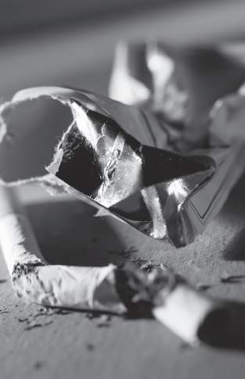
Conclusions from EQUIPP
Whether trying :
to prevent people from starting
to encourage quitting
to maintain abstinence or
to support quitters who relapse
Implementation of a comprehensive programme gives best results
The need for an Integrated approach is essential to successfully apply the report recommendations

Slide 23
What’s happened since then?
Art 14 - COP Uruguay,
15th - 20th November 2010

Slide 24
Art 14 WHO FCTC
Article 14 of the WHO Framework Convention on Tobacco Control (WHO FCTC) states that:
“each Party shall develop and disseminate appropriate, comprehensive and integrated guidelines based on scientific evidence and best practices,
taking into account national circumstances and priorities, and shall take effective measures to promote cessation of tobacco use and adequate treatment for tobacco dependence”.

Slide 25
Actions from COP4 on Article 14
Conduct a national situation analysis
Create or strengthen national coordination
Develop and disseminate comprehensive guidelines
Address tobacco use by health-care workers and others involved in tobacco cessation
Develop training capacity
Use existing systems and resources to ensure the greatest possible access to services
Make the recording of tobacco use in medical notes mandatory
Establish a sustainable source of funding for cessation help

Slide 26
Actions re. Treatment of Tobacco Dependence
Establish population-level approaches
Establish more intensive individual approaches
Make medications available
Consider emerging research evidence and novel approaches and media

Slide 27
Europe Quitting: Progress and Pathways

Slide 28
Conflict of interests
Professor Luke Clancy has received speaker and advisor fees from companies that develop and manufacture smoking cessation Medications and/or Medications for respiratory diseases

